Slide 1


CP 330: Edge AI Air Piano: Real-Time Finger Detection for Virtual Piano Playing
Sudhansu_24177, DM, sudhansu2024@iisc.ac.in
Vaibhav_24112, DM, gvaibha@iisc.ac.in
Siddharth_24857, DM, siddharthsa1@iisc.ac.in
Proff. Pandarasamy Arjunan, RBCCPS, samy@iisc.ac.in
Indian Institute of Science, Bangalore
Image source: https://leverx.com
Notes:
Source: https://leverx.com/

Slide 2
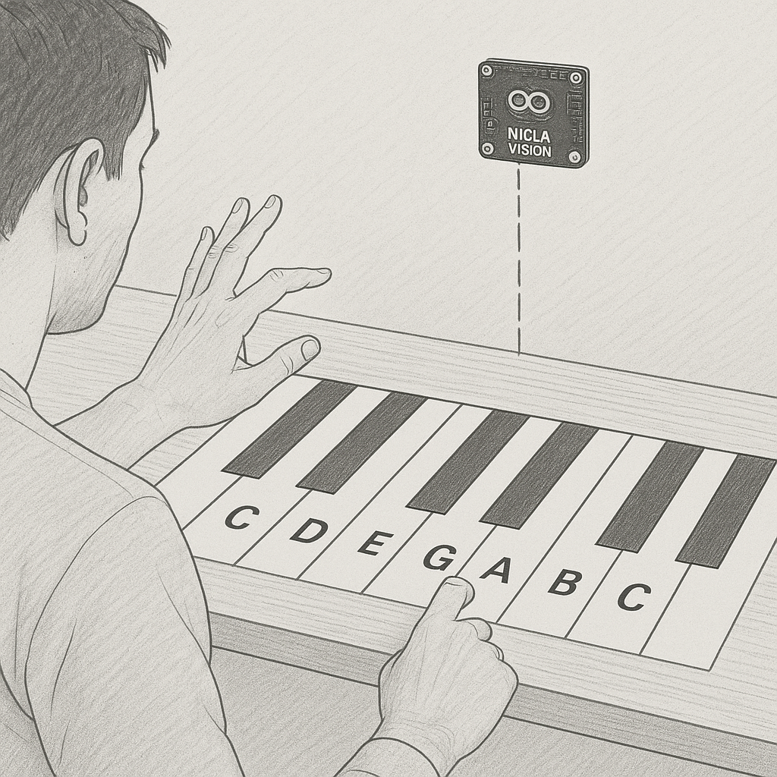
Introduction
Picture this: no piano, no keys, just you waving your hand in the air to create beautiful music!
With Edge AI on the tiny Nicla Vision, we bring an air piano to you.
You have to wave your fist to start, flick your finger in air to play—we are making music fun and futuristic!

Slide 3
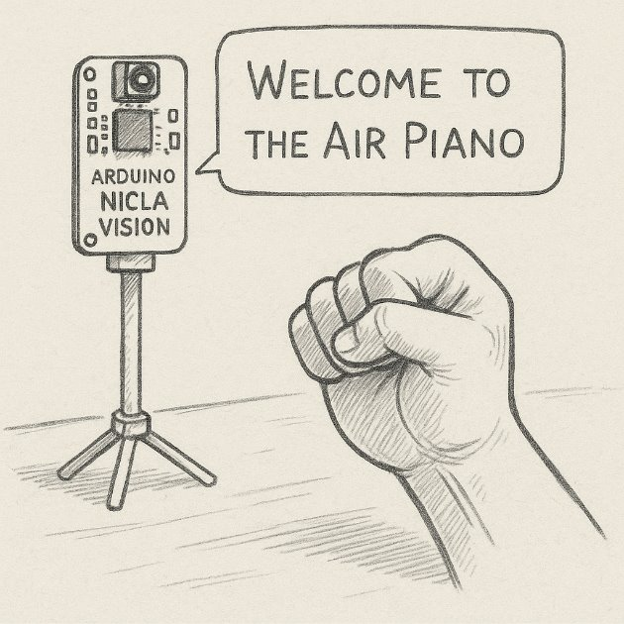
Motivation and Objectives
Why This Project?
No heavy stuff to carry! Big instruments like pianos are hard to move around. We wanted to make music easy by letting you play with just your hands in the air.
Won’t cost a lot! Some instruments are super expensive. Our idea makes music fun and affordable for everyone.
Super fun and friendly! Playing a piano just with our fingers dancing in the air! That’s the magic we wanted to bring to life.

Slide 4
Methodology
Here’s how it works:
Set Up the Camera: our script configures the Nicla Vision camera to capture images.
Preprocess the Image: The image is adjusted (cropped and resized) to work our model.
Run the Model: The script uses our trained FOMO model to find our index finger in the image.
Interpret Results: It figures out where our finger is and how big it looks.
Map to Piano Keys: the 8 piano keys your finger is over.
Detect a Press: It checks if our finger is “pressing” a key based on its size.
This happens over and over in a loop, so the piano responds as you move your finger!

Slide 5
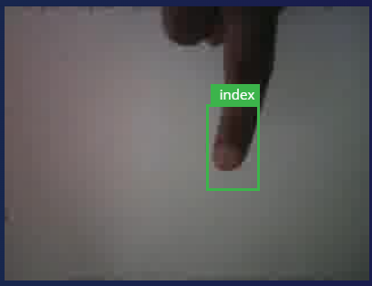
Methodology
The FOMO model running on the Nicla Vision processes each
frame and returns
Label: "index"
Confidence Score: A number (e.g., 0 to 1)
Bounding Box: Coordinates (x, y, width, height)
Mapping to Piano Keys
Key Zones: splits the image’s width (e.g.240 pixels) into 8 equal zones, each representing one of 8 piano keys. Since 240 ÷ 8 = 30, each key zone is 30 pixels wide.
Key 0: 0–29 pixels
Key 1: 30–59 pixels
...and so on, up to Key 7: 210–239 pixels.
Finger Position: calculating the finger’s horizontal center (center_x = x + width / 2) and determines which key zone it falls into by dividing: key = center_x // 30.

Slide 6
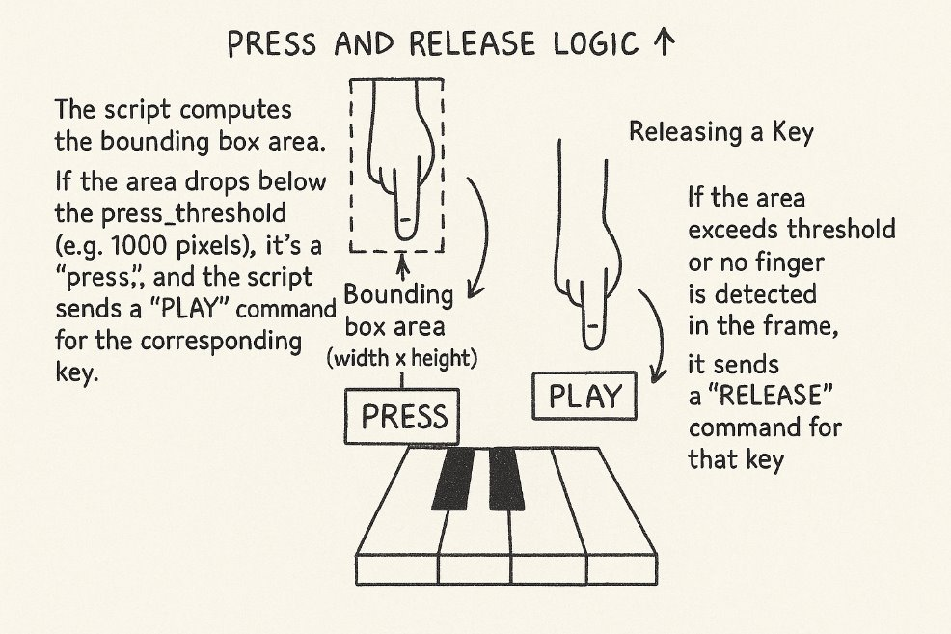
Methodology
When your finger moves closer to the Nicla Vision, it appears larger in the camera’s field of view.
bigger bounding box, so the area increases and vice versa.
Calculate area of box from h*w
Using above logic
moving down (closer to the table) means "press" (smaller area)
moving the finger up (closer to the Nicla) means "release" (larger area)

Slide 7
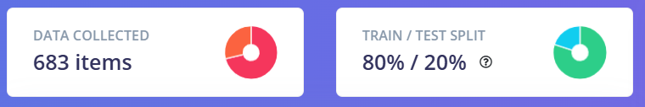
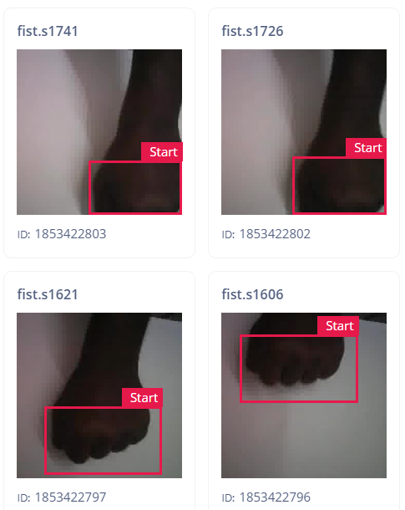
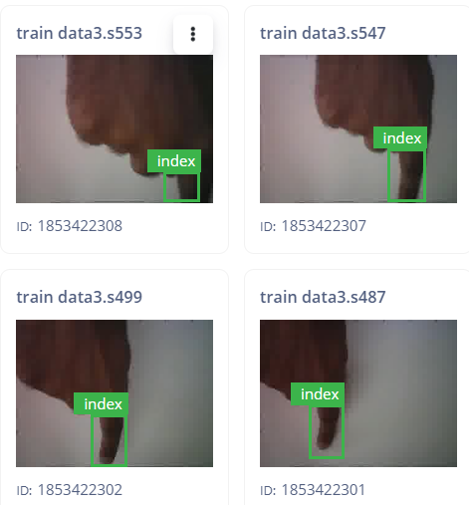
Data Collection
Data collected using a Nicla Vision board mounted 35 cm above a table surface - capturing video of an index finger interacting with a virtual piano interface.
which were split into individual images for processing in Edge Impulse.
The total number of samples is approximately 683 images, derived from a 3 -minute video, with a subset used for training (546images) and validation (137 images) after preprocessing.

Slide 8
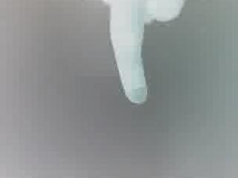


Data Collection
class of interest, labeled "index finger," and "fist" with bounding box annotations applied to frames where the index finger and fist is visible.
Annotations were manually created in Edge Impulse, marking the finger’s position and size within each frame.
Unannotated images, representing the "background" class (no finger present), were implicitly included as negative examples.
Using Google Colab, we augmented our image dataset by applying diverse transformation techniques like rotation, scaling, and flipping. This process expanded our raw dataset, and we now have a total of 1689 images available for computer vision training.

Slide 9
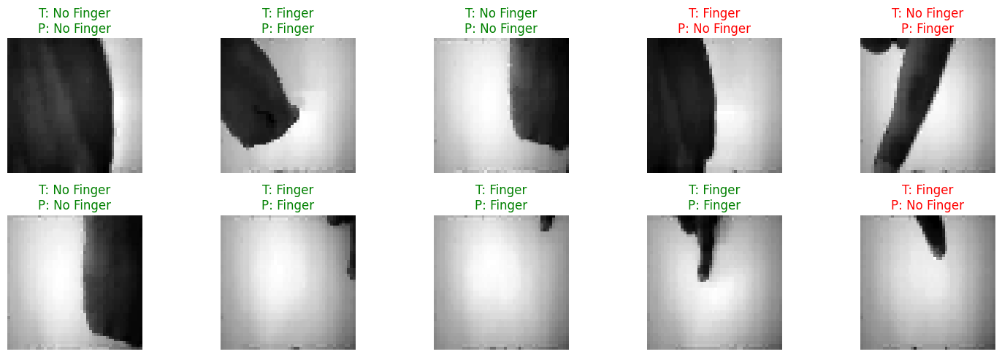
Model Development (Colab)
The images were initially captured in RGB format at a resolution of 320x240 and later processed in grayscale at 48x48 for model training to optimize performance on the resource-constrained Nicla Vision.
Before Quantization | After Quantization (int8)
Size: 351.41 KB | Size: 96.40 KB
Accuracy : 74.34% | Accuracy : 55.75%

Slide 10
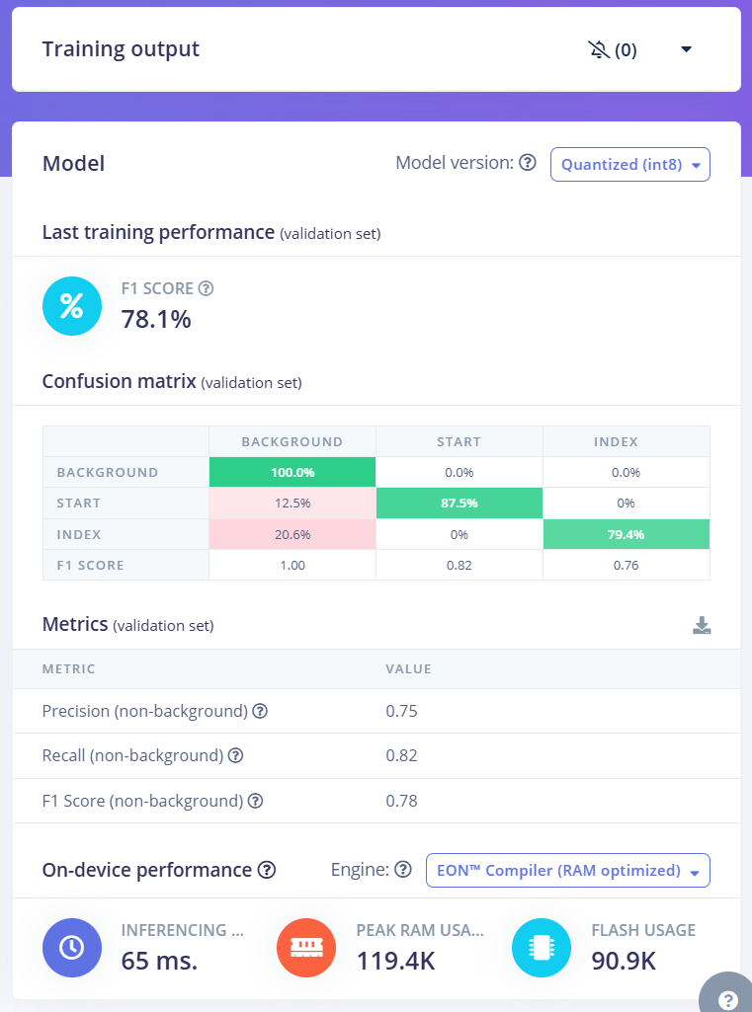
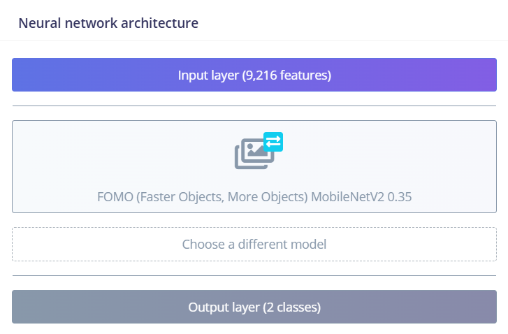
Model Development (edge impulse)

Slide 11

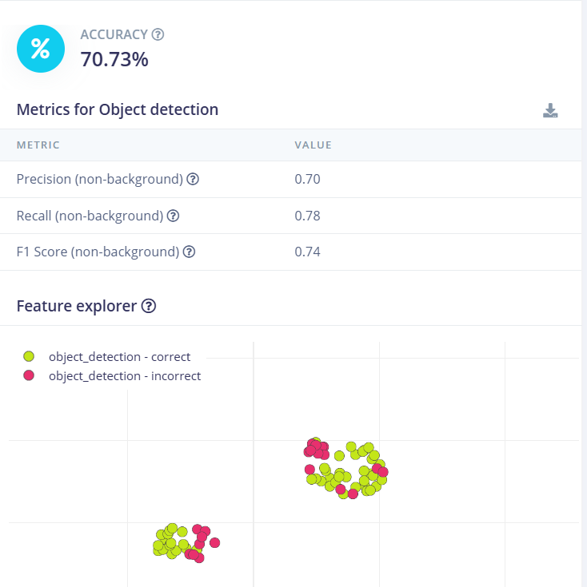
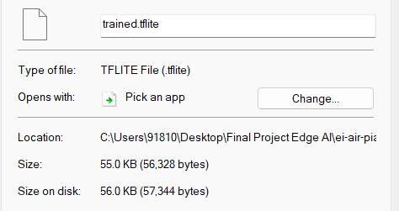
Model Development
Finally deployed model on Nicla vision for inference - Size = 56kb
- Accuracy = 70.73%
- Inference time = 65ms

